Slide 1
Interpretation of Data: Telling Your Story Well
Darby Roberts, PhD
Student Affairs Planning, Assessment & Research
Texas A&M University
Notes:
Darby
Introduce ourselves

Slide 2
“Maybe stories are just data with a soul.”
— Brene' Brown, 2010
Notes:
Darby
We are all assessment people, we are all story tellers, we are all conduits to others who care about and support our programs.

Slide 3
Assessment
Collecting meaningful data, reflecting on results, making decisions about actions, following up to see if actions made a positive difference
Used for unit/program improvement and accountability
Notes:
Darby
Purposeful
Transparent
Internal purpose/focus

Slide 4
Typical Assessment Cycle
Planning
Data Collection
Analysis/
Meaning
Sharing Results
Using Results
Vision
Mission
Goals
Outcomes
Notes:
VMGO set the foundation for what you do, what is important, who your audience is, and what you want to accomplish in the future. Align with larger goals and outcomes
Planning—delivery of programs and services to an identified audience, as well as how you are going to assess what you do (could be small/large scale, formal/informal, qualitative/quantitative)
Data collection—timing, qualitative/quantitative, creating good questions that might serve multiple purposes. Think of stakeholders' needs.
Analysis—finding meaning, interpreting, what is meaningful or surprising.
Sharing—transparency, purpose, who need to know what when and how (nugget, full report), participants, assessment people are translators, communicate value and impact
Using—taking action for improvement, short/long term, seek resources, building relationships, garnering resources
Cycle—never ends.

Slide 5
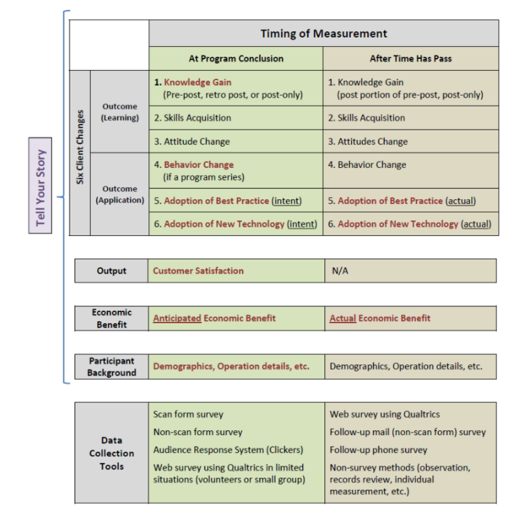
Evaluation Overview

Slide 6
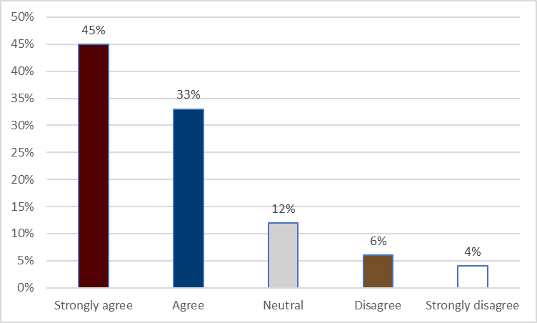
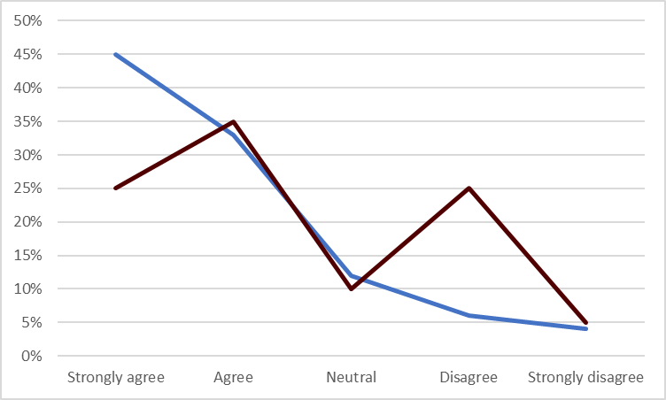
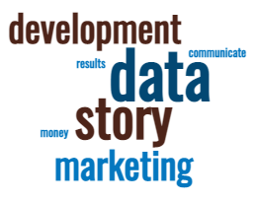
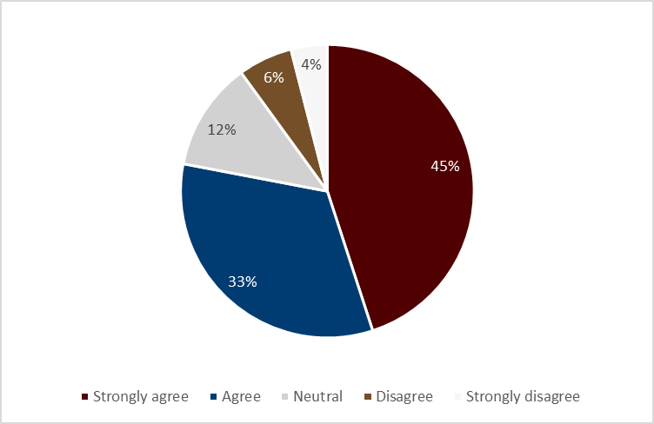
Sharing Results
Tables
Bar Charts
Line Graphs
Pie Charts
Heat Maps
Word Clouds
Dashboards
Notes:
Can be one time, longitudinal, comparison, etc. (We tend to do tables for brevity and longitudinal)
Know your audience, be creative
Examples: put some results from a recent conference on your website to market for the next one.

Slide 7
Sharing Results (cont.)
Press releases
Newsletters
Your website
Email with a link to the story
Photos & videos
Social media posts
Digital signs
Brochures
Banners or sandwich boards
Posters/flyers/table tents
Written report
Notes:
Spectrum of more/less work, time energy, return
We do written reports and dashboards to give you a comprehensive view of what you asked us to do. (Why we push to have fewer, but more meaningful and actionable, questions

Slide 8
“Counting without a narrative is meaningless and narrative without counting is suspicious.”
— Lee S. Shulman, 2007
Notes:
Transition to Sondra—we can count a lot of things, but we need to put meaning with them.

Slide 9
Why Tell Good Stories?
Stories are how we make sense of the world.
Demonstrate the value and worth of what you do
Stakeholders want and deserve proactive, engaging communication
Build trust, transparency, accountability
Curate future supporters
The role of an institution is to give an account of its contribution to the education of its students.
-Jankowski & Baker (2019)
Notes:
Stories
Branding

Slide 10
"Good stories surprise us. They make us think and feel. They stick in our minds and help us remember ideas and concepts in a way that a PowerPoint crammed with bar graphs never can."
— Joe Lazauskas and Shane Snow, The Storytelling Edge (2018)

Slide 11
Evidence-Based Storytelling Model
Adapted from: Jankowski, N. A., & Baker, G. R. (2019, October). Building a narrative via evidence-based storytelling: A toolkit for practice. Urbana, IL: University of Illinois and Indiana University, National Institute for Learning Outcomes Assessment (NILOA). Retrieved from https://www.learningoutcomesassessment.org/wp-content/uploads/2019/10/EBST-Toolkit.pdf

Slide 12
Audience
Who is the target audience(s)?
Is it internal or external?
Are there other audiences who may be interested?

Slide 13
Argument
What argument do you want to make to your target audience?
What are the goals for the story?
What do you want the audiences to take away from the story?

Slide 14
Evidence
What evidence do you have to assert your claims?
What counts as compelling evidence?
Do you have that evidence?
Is it evidence you think they should be aware of?

Slide 15
Story and Language
What kind of story are you telling?
Is you audience interested in that type of story?
What context is needed to understand the story?
What is the setting?

Slide 16
Characters
Who are the characters in your story?
Can your audience identify with the characters?
What are the motivations of the characters?

Slide 17
Plot
What is the plot? (causal sequence of events)
What conditions need to be included?
What are we trying to address or overcome?
What is the argument you need to make to provide support from the evidence provided?
How might audience use the information moving forward?

Slide 18
Data Visualization
Are the visuals appropriate for your story?
Do they support or detract from your story?
Did you make meaning for the stakeholder (or expecting them to make sense of it)?

Slide 19
Awareness and Discovery
What is the best medium to share your story?
Which means best reach your target audience(s)?
How will you make them aware of it and how will they find it?

Slide 20
Questions and Discussion

Slide 21
Key Takeaways
Talk about assessment in the context of planning and communicating
Translate assessment results to your stakeholders’ language
Anticipate, and communicate to, stakeholders’ interests
Continually share your story in a variety of ways
Notes:
Always have clear talking points.
People should have knowledge of your department and the Division.
If you are a NASPA member, you can join the Student Affairs Fundraising and Communications Knowledge Community and/or the Assessment, Evaluation, and Research Knowledge Community.

Slide 22
“Evidence gives stories substance, but stories give evidence meaning.”
— Natasha Jankowski, 2021
Notes:
We are all assessment people, we are all story tellers, we are all conduits to others who care about and support our programs.

Slide 23
Thank you!

Slide 24
Resources
Balliett, A. (2020). Killer visual strategies: Engage any audience, improve comprehension, and get amazing results using visual communication. Wiley.
Brown, B. (2010). The power of vulnerability. Retrieved from https://www.ted.com/talks/brene_brown_the_power_of_vulnerability
Jankowski, N. (2021, January). Evidence-based storytelling in assessment. (Occasional Paper No. 50). Urbana, IL: University of Illinois and Indiana University, National Institute for Learning Outcomes Assessment. Retrieved from https://www.learningoutcomesassessment.org/wp-content/uploads/2021/02/Occasional-Paper-50_EBST.pdf
Jankowski, N. A., & Baker, G. R. (2019, October). Building a narrative via evidence-based storytelling: A toolkit for practice. Urbana, IL: University of Illinois and Indiana University, National Institute for Learning Outcomes Assessment (NILOA). Retrieved from https://www.learningoutcomesassessment.org/wp-content/uploads/2019/10/EBST-Toolkit.pdf
Jankowski, N., Mello, B., & Levy, J. (2020). The evidence-based storytelling toolkit: Using assessment data to write your learning narrative. Retrieved from https://www.youtube.com/watch?v=TutW9VCam8A
Lazauskas, J., & Snow, S. (2018). The storytelling edge. Retrieved from https://www.youtube.com/watch?v=yi5Xa-Xkqd0
Richards, M. (March 25, 2021). Fostering a culture of assessment. Retrieved from https://www.insidehighered.com/blogs/call-action-marketing-and-communications-higher-education/fostering-culture-assessment?utm_source=Inside+Higher+Ed&utm_campaign=67ea99d4d2-DNU_2021_COPY_02&utm_medium=email&utm_term=0_1fcbc04421-67ea99d4d2-198219525&mc_cid=67ea99d4d2&mc_eid=e8c3e530ca

