Slide 1
TEXAS A&M AGRILIFE
Employee Assistance Program
Resources Designed to Help You
Presented by Elizabeth Schwartz, Chief HR Officer

Slide 2
Overview
Employee Assistance Program – Guidance Resources
Mental Health Coverage A&M Care Plan
Other Wellness

Slide 3
This Photo by Unknown Author is licensed under CC BY

Slide 4
Employee Assistance Program
System-Level Contract with ComPsych – Guidance Resources
Available to A&M System employees at no cost
Work/Life Solutions Program includes counseling, legal and financial consultation, work-life assistance and crisis intervention to all employees and their household family members
https://employees.tamu.edu/eap/_media/documents/worklifesolutionsresources.pdf

Slide 5
Counseling Sessions
Intended to be short-term in nature
Up to Five (5) face-to-face counseling sessions per covered individual, per year
Sessions during the employee’s regular work schedule are considered business time and sick leave is not needed to cover this time
If additional treatment is needed beyond five sessions, you will be provided a referral and your insurance coverage may be used and appropriate leave must be taken

Slide 6
What Happens When You Call
You will be connected to a counselor who will collect some general information about your needs.
From there, you will get referred to a counselor who can assist you, with a schedule phone or in-person session
Completely confidential

Slide 7
How To Access:
Website: http://www.guidanceresources.com
WEBID: TAMUS
Phone Numbers:
Active Employees 1-866-301-9623
Retirees 1-833-306-0105

Slide 8
More Than Counseling
Referrals for addiction issues
Other personal issues that impact your work life – elder care, divorce, debt management
Crisis services can be arranged for your location – Contact HR

Slide 10
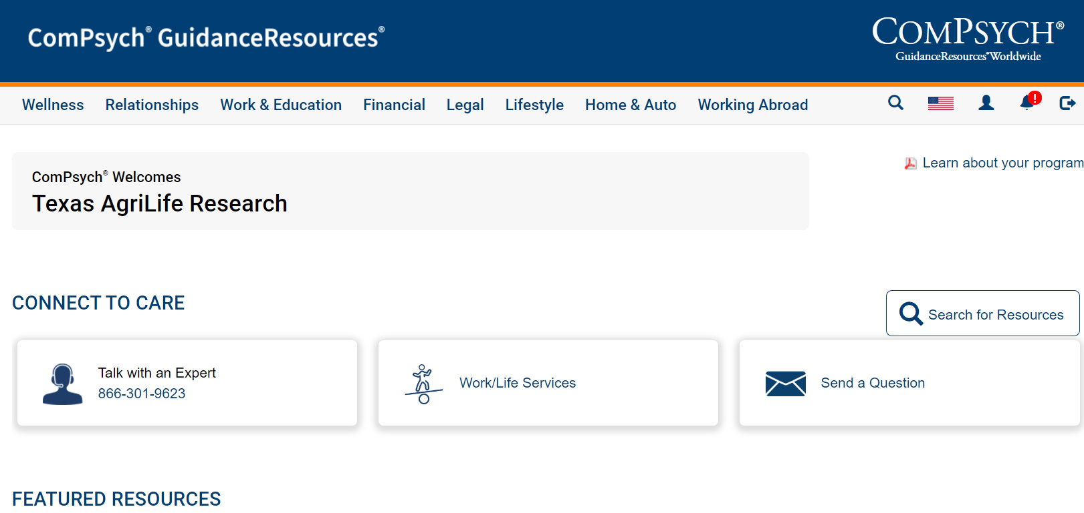

Slide 11
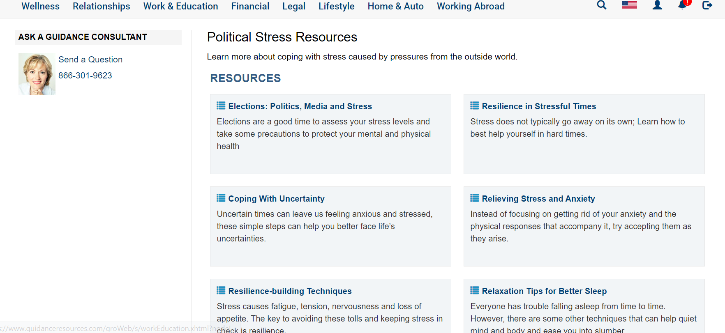

Slide 12
Mental Health Coverage Under the A&M Care Plan
For mental health or substance abuse medical needs beyond the five EAP sessions, your A&M Care Health Plan may be used
Always look for an In-Network Provider when possible
Consult Benefits resources for pre-authorization for in-patient and other treatment
https://assets.system.tamus.edu/files/benefits/website/BenefitsGuide.pdf

Slide 13
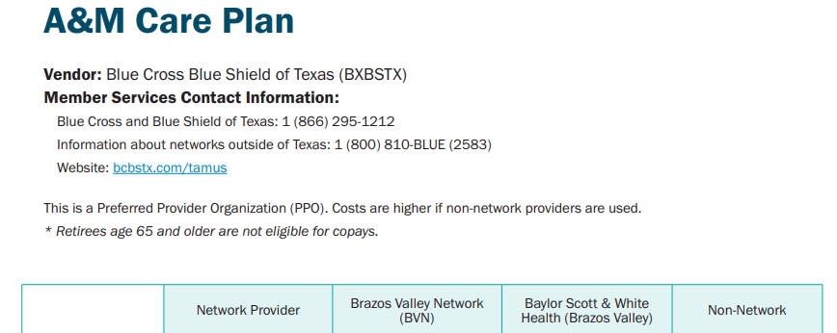

Slide 14
Other Wellness
In general, follow basic wellness principles to take the best care of yourself physically and mentally
Seek help from available resources; reach out to HR or your office unit contact for more information
Reach out to HR for guidance if you have concerns about a colleague or employee

Slide 15
Q&A
This Photo by Unknown Author is licensed under CC BY-SA-NC

Slide 16
Contact Us
Phone Number
979.845.2423
Email Address
AgrilifeHR@ag.tamu.edu
Website
https://agrilifeas.tamu.edu/hr/about-us/eap/

