Slide 1
Feeling Overwhelmed? You’re Not Alone! An Exploration of the 7 Types of Rest
AgriLife Extension State Conference
August 17, 2022
Presented by Daphne Richards

Slide 3
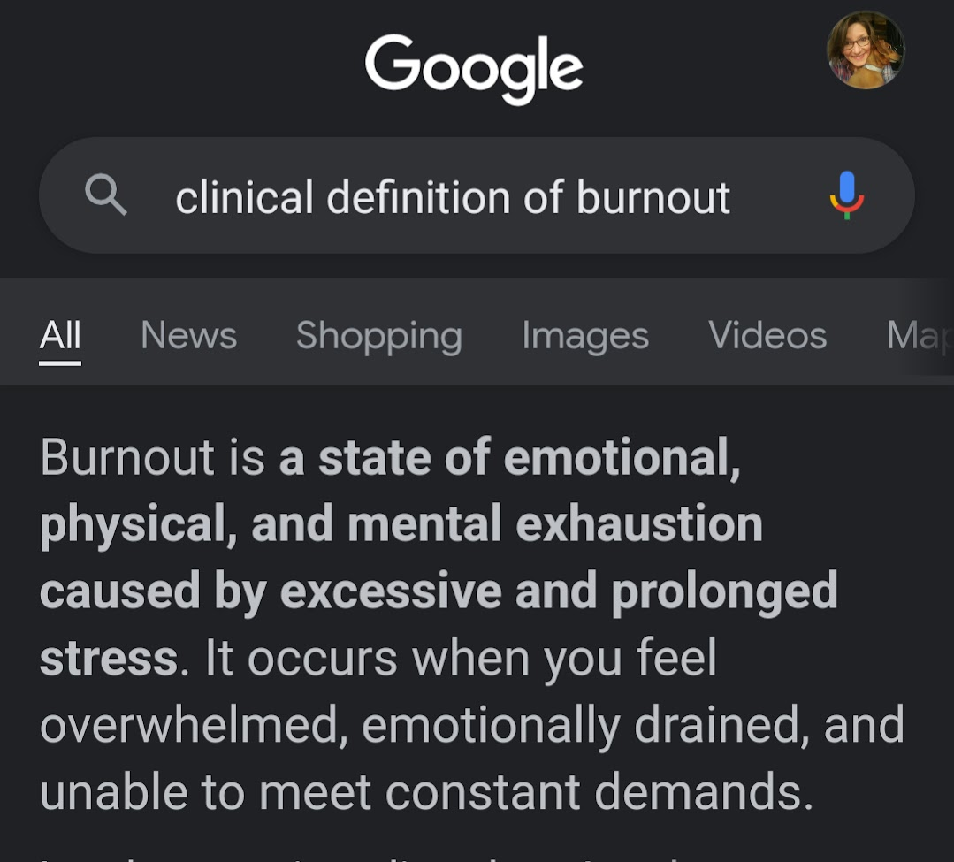

Slide 5
It’s only Monday! It’s only Monday! It’s only Monday!

Slide 6
A friend or colleague asks how you’re doing…
How do you respond?

Slide 7
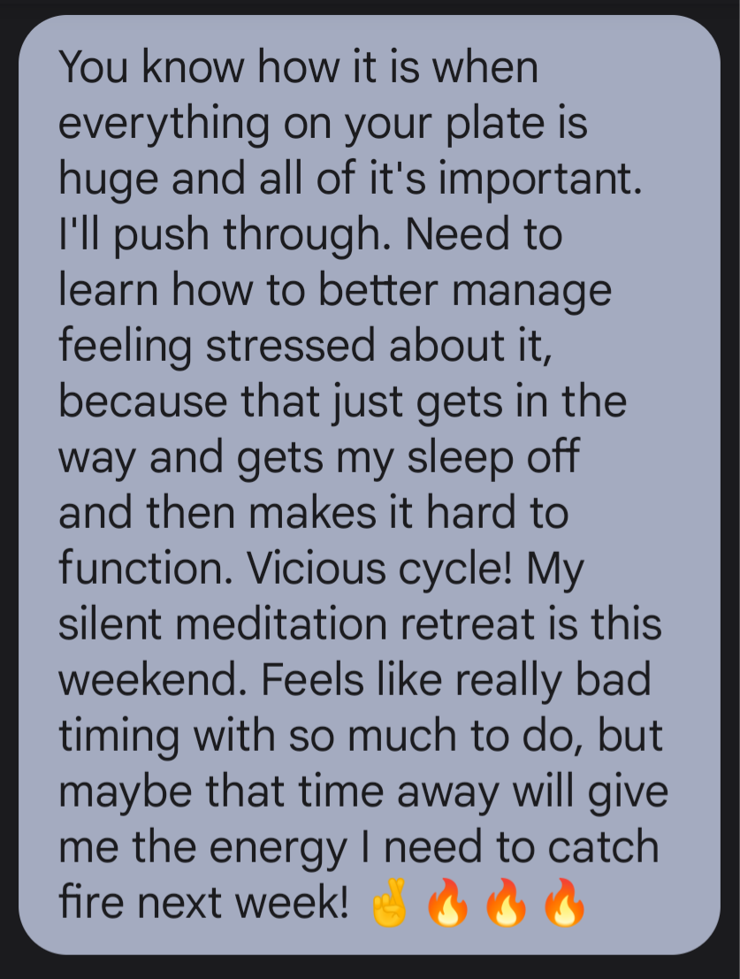
Or… your boss asks?

Slide 8
Things are often challenging

Slide 9
Daphne Richards – President-elect

Slide 10
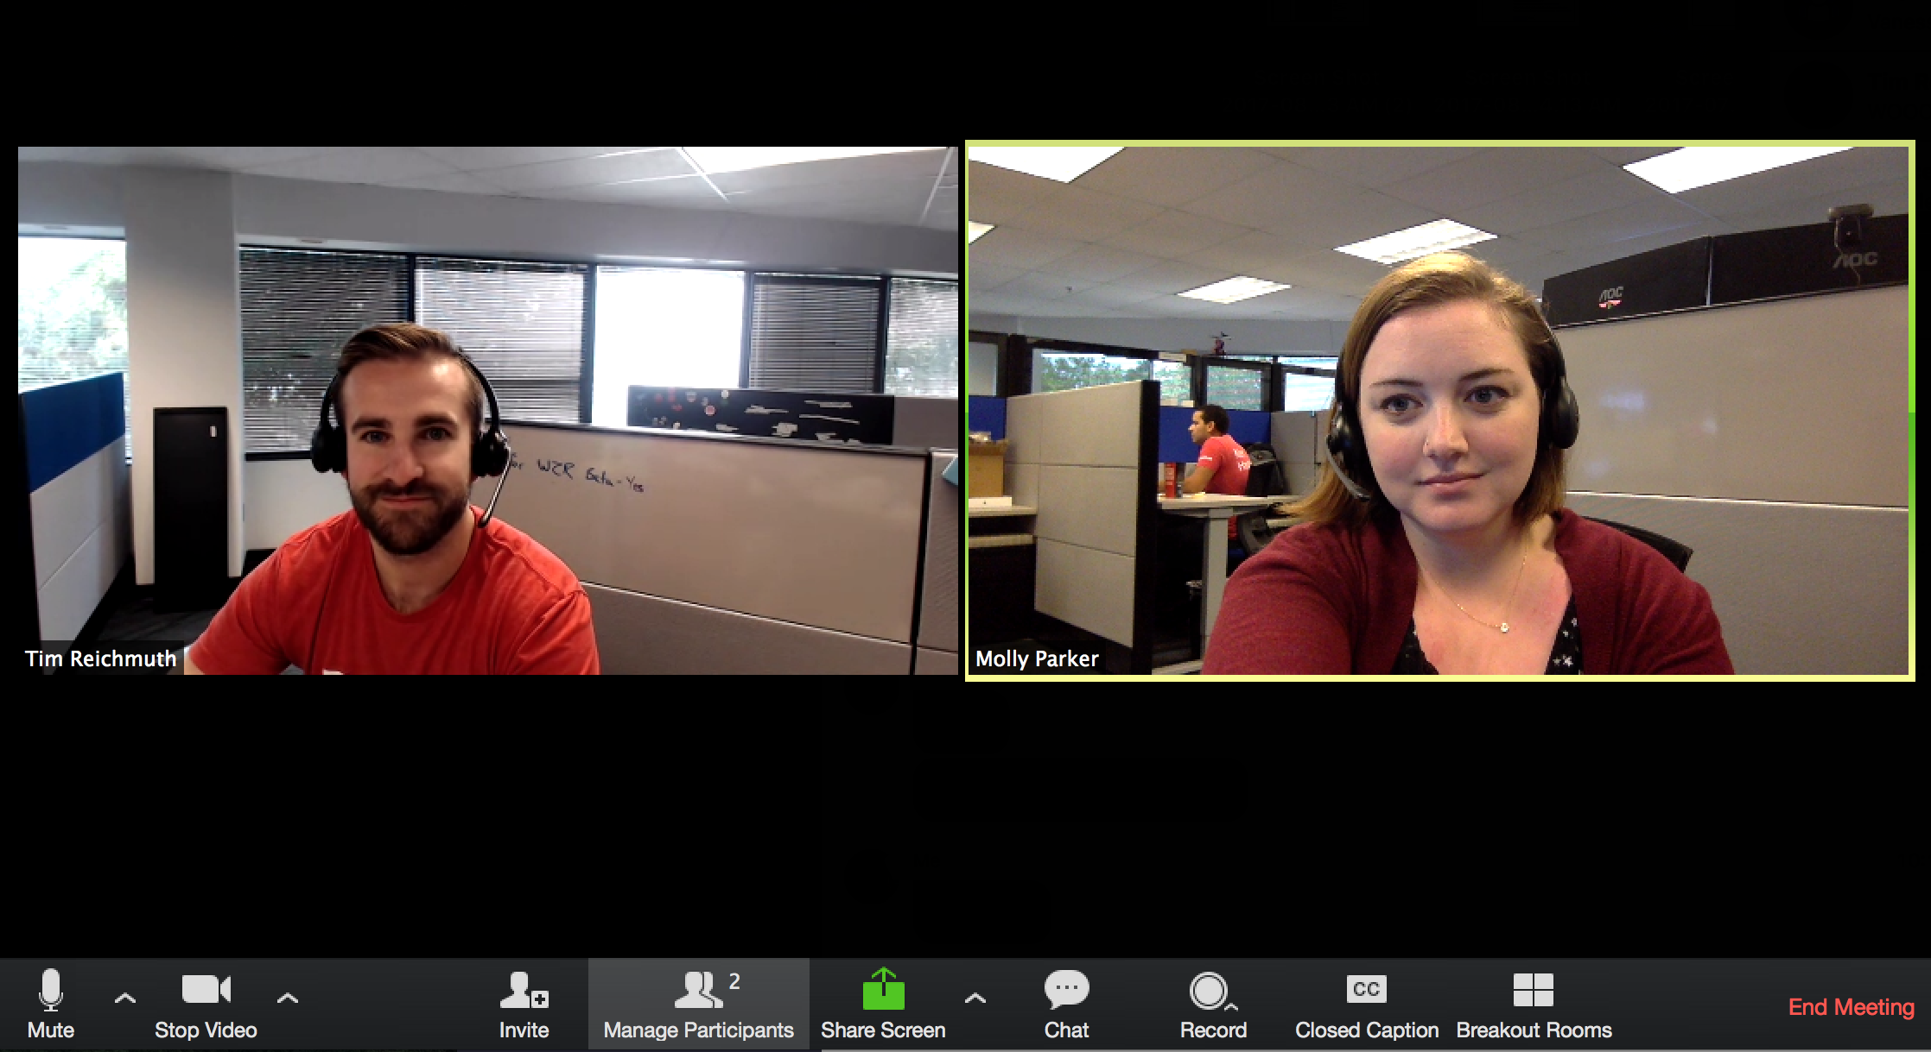
A recent discussion…
Notes:
When you’re the host of the meeting and your fist participant shows up early…chit chat. Recent two discussions between Jennifer Wilson and Daphne Richards about how we were doing at the time. First meeting…basically, we were struggling. Next meeting, two weeks later, in response to the same question, Jennifer responds that things are better. And Daphne says, things really aren’t better, but I feel like I’m handling them better. Which got me to wondering just what was different.

Slide 11
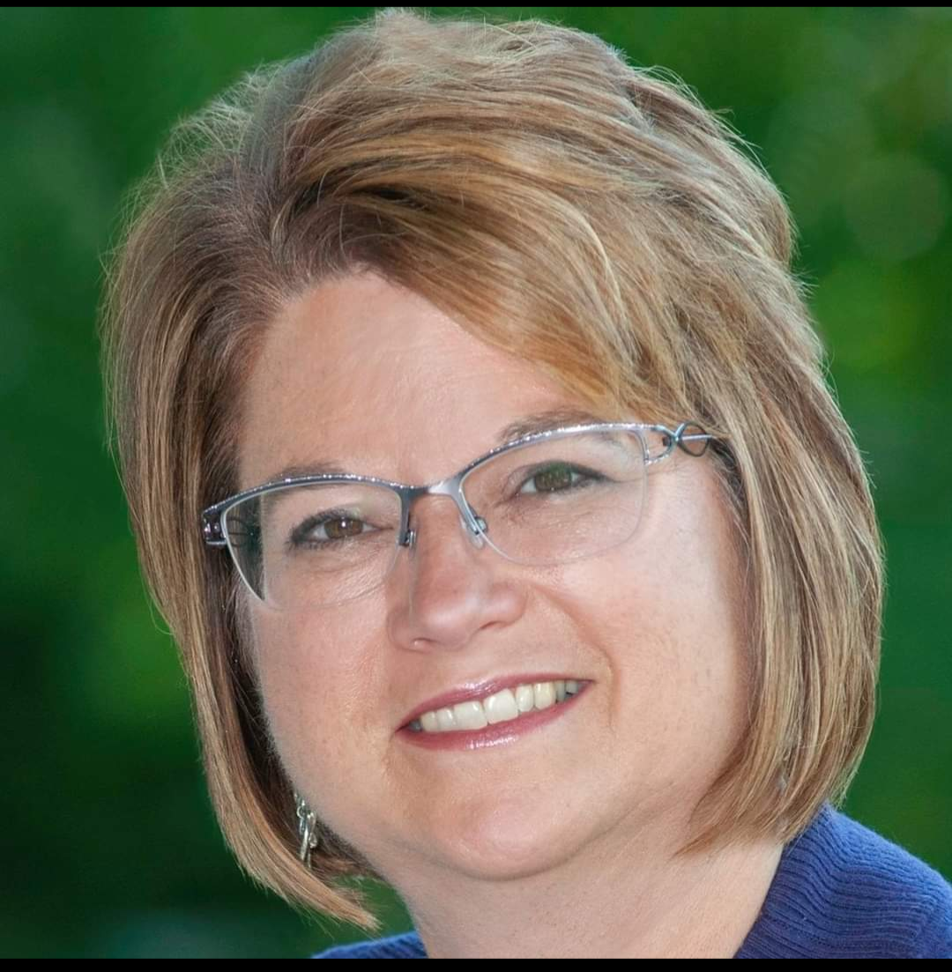
Two weeks later…
Notes:
When you’re the host of the meeting and your fist participant shows up early…chit chat. Recent two discussions between Jennifer Wilson and Daphne Richards about how we were doing at the time. First meeting…basically, we were struggling. Next meeting, two weeks later, in response to the same question, Jennifer responds that things are better. And Daphne says, things really aren’t better, but I feel like I’m handling them better. Which got me to wondering just what was different.

Slide 12
Inspired by Weekly Jones Zone on “energy”
Jones Loflin suggested asking yourself: What type of rest do I need right now?
Notes:
What type of rest do I

Slide 13
Getting plenty of sleep but still feel exhausted? Rest is about more than sleep.
Personal Rest Deficit Assessment Tool
worksheet
AgriLife State Conference
August 17, 2022 | Daphne Richards

Slide 14
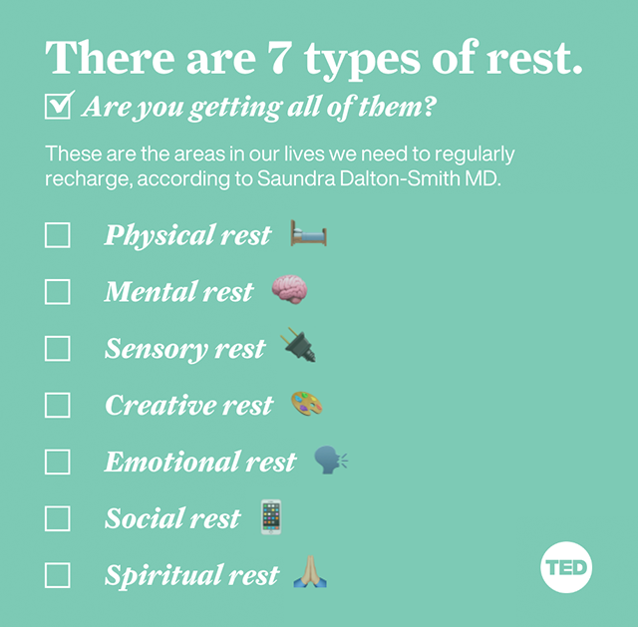

Slide 15
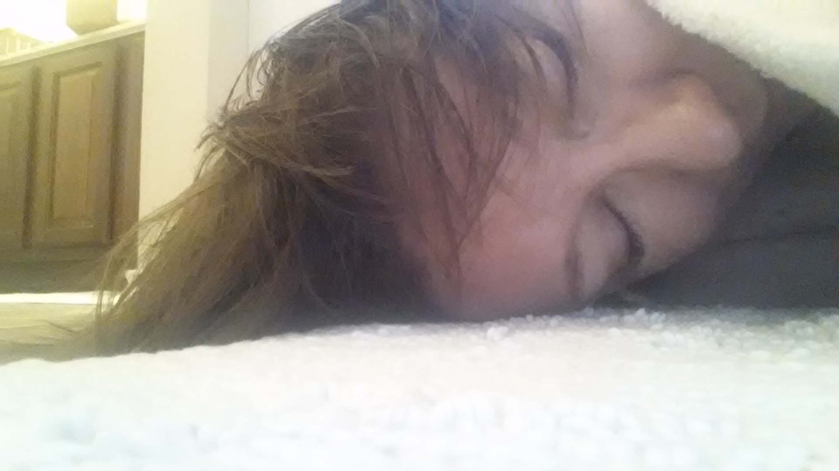
1. Physical Rest
When you lay your body down
Signs that you need physical rest:
You experience frequent pain or illness
You lack the energy to accomplish tasks
You feel tired, but can’t sleep
You rely on caffeine/sleep aids
Daphne Richards | Epsilon Sigma Phi national board

Slide 16
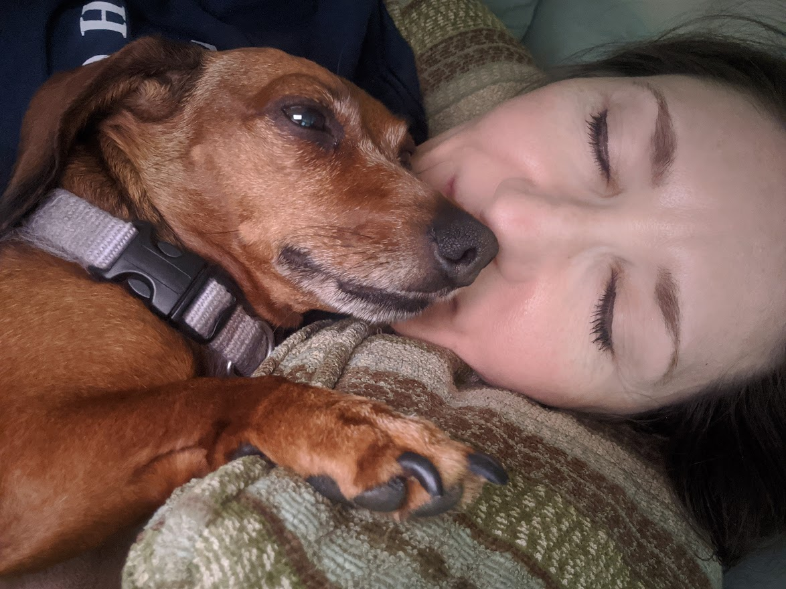
1. Physical Rest
When you lay your body down
Two types of physical rest:
Passive includes sleeping or napping
Active includes stretching and deep breathing
Daphne Richards | Epsilon Sigma Phi national board

Slide 17
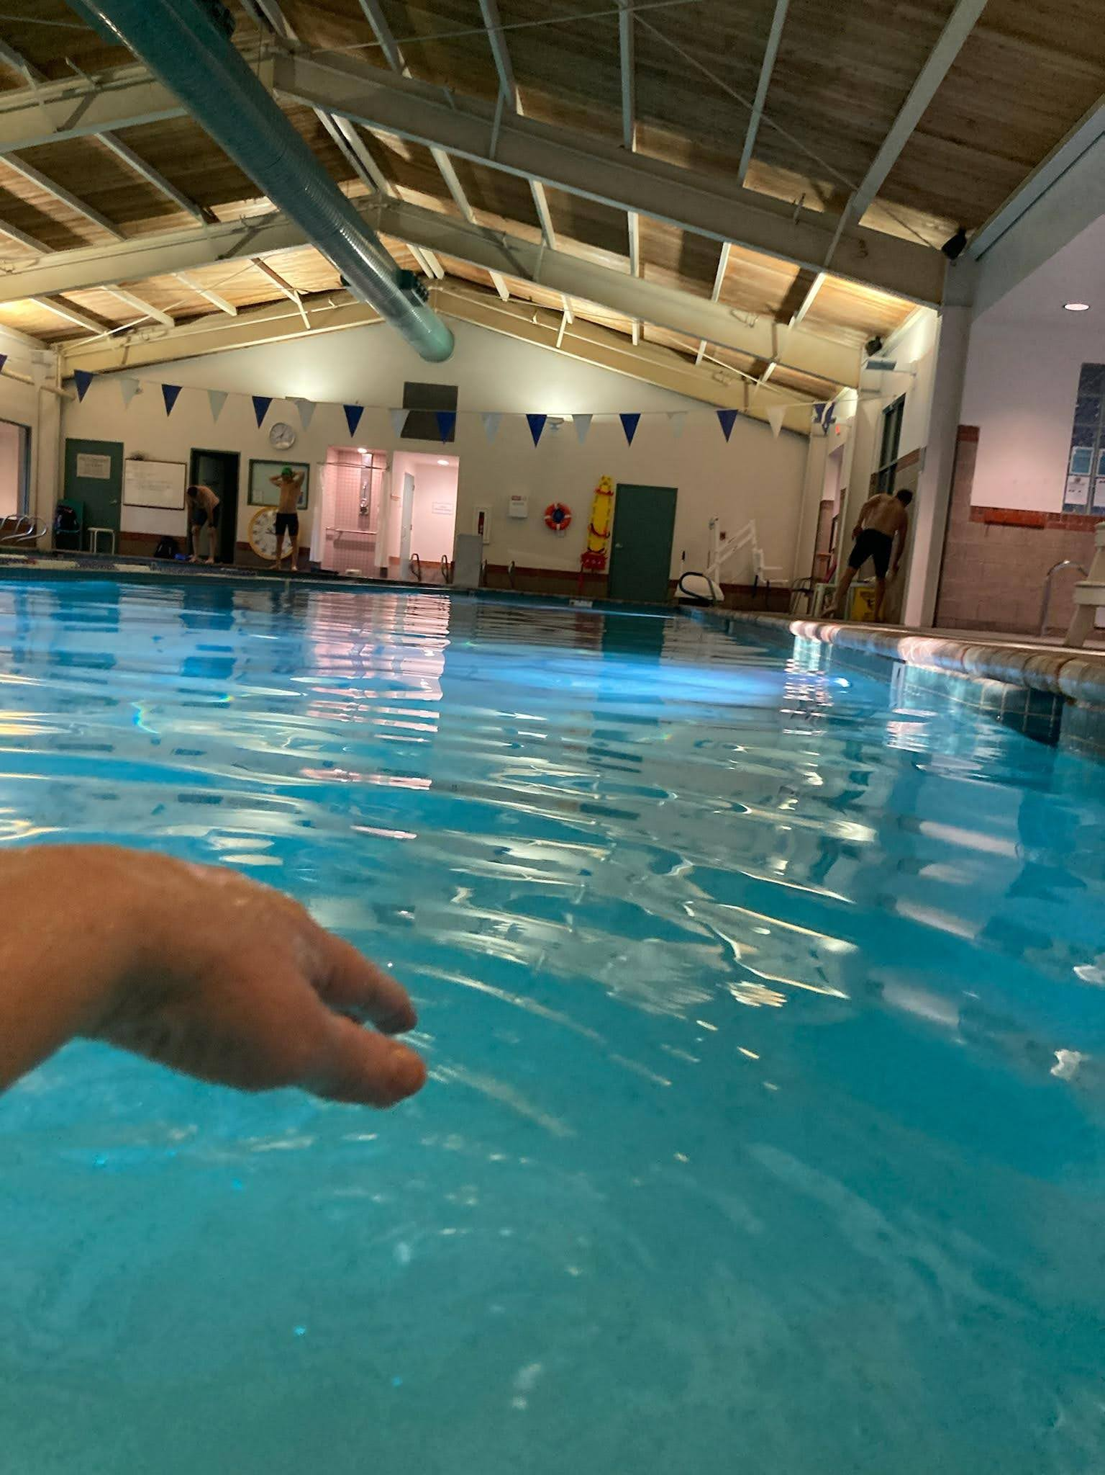
1. Physical Rest
When you lay your body down
Ways to get physical rest:
Gentle forms of exercise
Stretching
Standing/moving
Deep breathing
Daphne Richards | Epsilon Sigma Phi national board

Slide 18
2. Mental Rest
Quiet the cerebral background noise
Signs that you need mental rest:
You have mental fog
You’re easily irritated or frustrated
You feel overwhelmed
Daphne Richards | Epsilon Sigma Phi national board

Slide 19
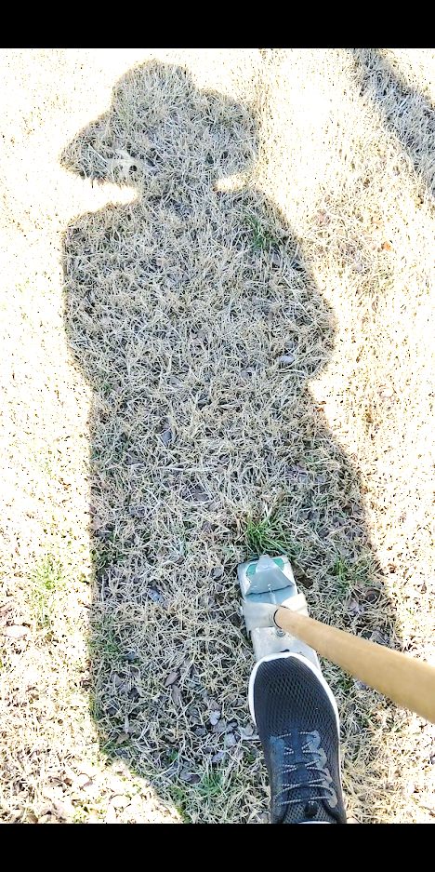
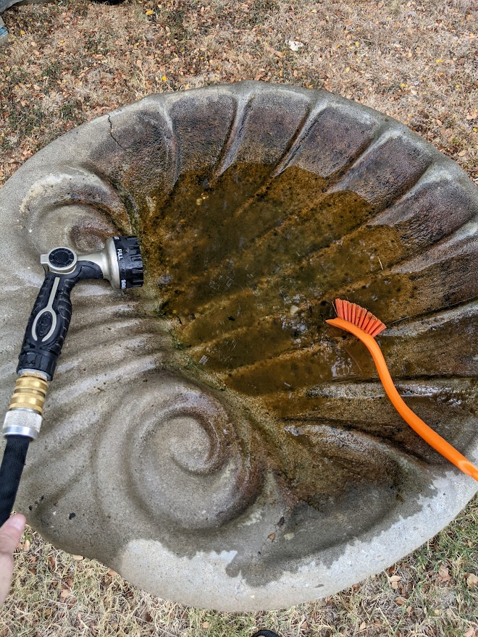
2. Mental Rest
Quiet the cerebral background noise
Ways to get mental rest:
Do something “mindless”
Purge mind before bed to declutter mental space
Time block low-yield activities
Daphne Richards | Epsilon Sigma Phi national board

Slide 20
3. Sensory Rest
Remove external distractions
Signs that you need sensory rest:
You’re overly sensitive to sound or light
You have eye strain/fatigue
You’re sensitive to “personal space”
Daphne Richards | Epsilon Sigma Phi national board

Slide 21
3. Sensory Rest
Remove external distractions
Ways to get sensory rest:
Spend time in nature
Unplug/limit screen time
Spend intentional time in darkness
Daphne Richards | Epsilon Sigma Phi national board

Slide 22
4. Creative Rest
Soak in beauty and light
Signs that you need creative rest:
You neglect self-care activities
You focus mainly on the needs of others
You feel unappreciated
Daphne Richards | Epsilon Sigma Phi national board

Slide 23
4. Creative Rest
Soak in beauty and light
Ways to get creative rest:
Build Sabbaticals/vacations into your life
Practice flow-break rhythm
Block space for “nothing time”
Daphne Richards | Epsilon Sigma Phi national board

Slide 24
5. Emotional Rest
Acknowledge your current truth
Signs that you need emotional rest:
You worry excessively
You feel constantly anxious
You focus on your failures/flaws
Daphne Richards | Epsilon Sigma Phi national board

Slide 25
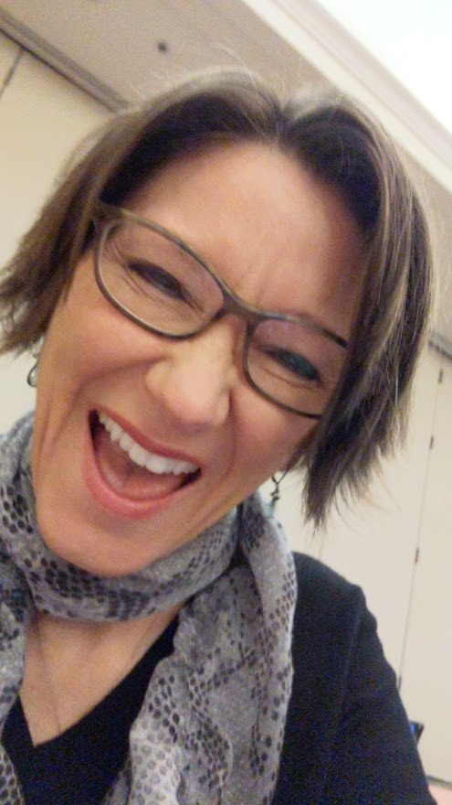
5. Emotional Rest
Acknowledge your current truth
Be honest about how you truly feel
Cultivate time with people who refresh you
Avoid people who drain you
Ways to get emotional rest:
Daphne Richards | Epsilon Sigma Phi national board

Slide 26
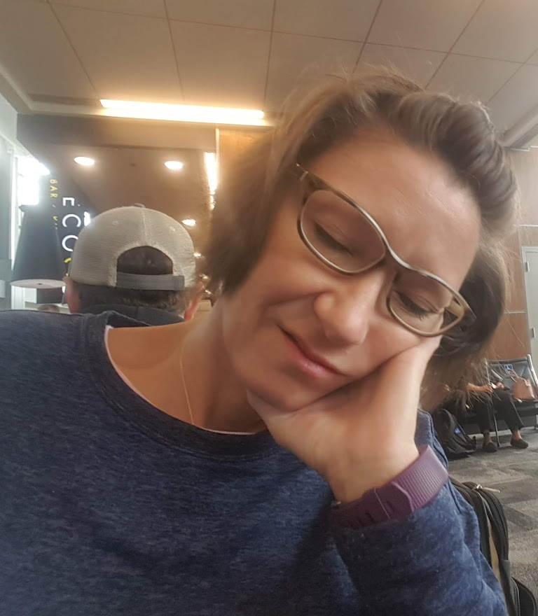
6. Social Rest
Finding solace in others
Signs that you need social rest:
You choose to isolate more than usual
You avoid social interactions
You feel detached
Daphne Richards | Epsilon Sigma Phi national board

Slide 27
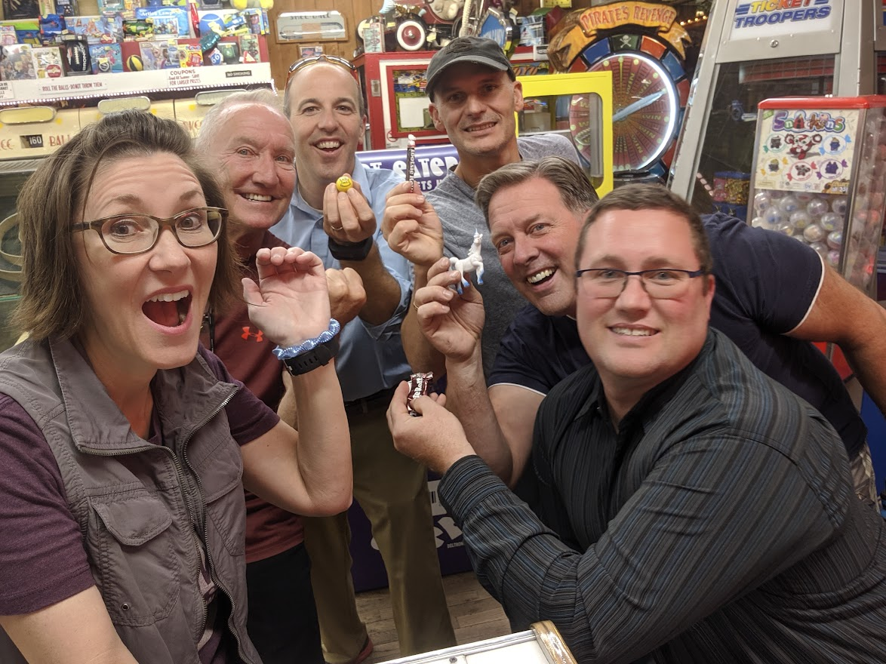
6. Social Rest
Finding solace in others
Ways to get social rest:
Prioritize face-to-face time
Be your authentic self
Maintain meaningful connections
Daphne Richards | Epsilon Sigma Phi national board

Slide 28
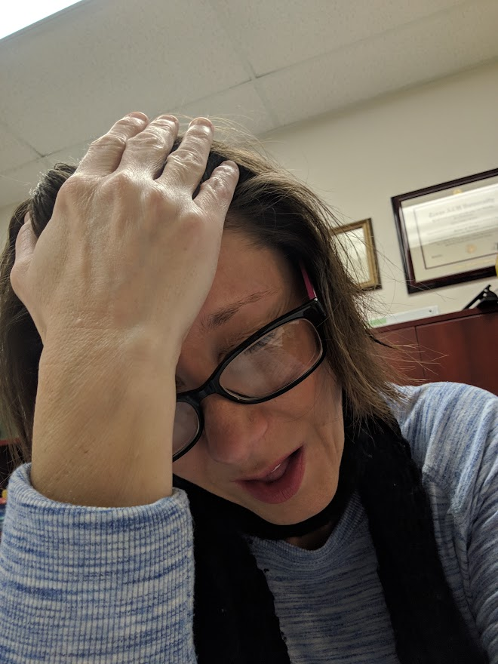
7. Spiritual Rest
Enter your personal sanctuary
Signs that you need spiritual rest:
You feel decreased satisfaction
You have no motivation
You feel hopeless or apathetic
Daphne Richards | Epsilon Sigma Phi national board

Slide 29
7. Spiritual Rest
Enter your personal sanctuary
Ways to get spiritual rest:
Commune with nature/pets
Find connection to a greater purpose
Practice prayer/meditation/immersion
Daphne Richards | Epsilon Sigma Phi national board

Slide 30
Getting plenty of sleep but still feel exhausted? Rest is about more than sleep.
Personal Rest Deficit Assessment Tool
worksheet
AgriLife State Conference
August 17, 2022 | Daphne Richards

Slide 31
Recover your life, renew your energy, restore your sanity
I try to get at least 10 minutes of all seven types of rest, every day

Slide 32
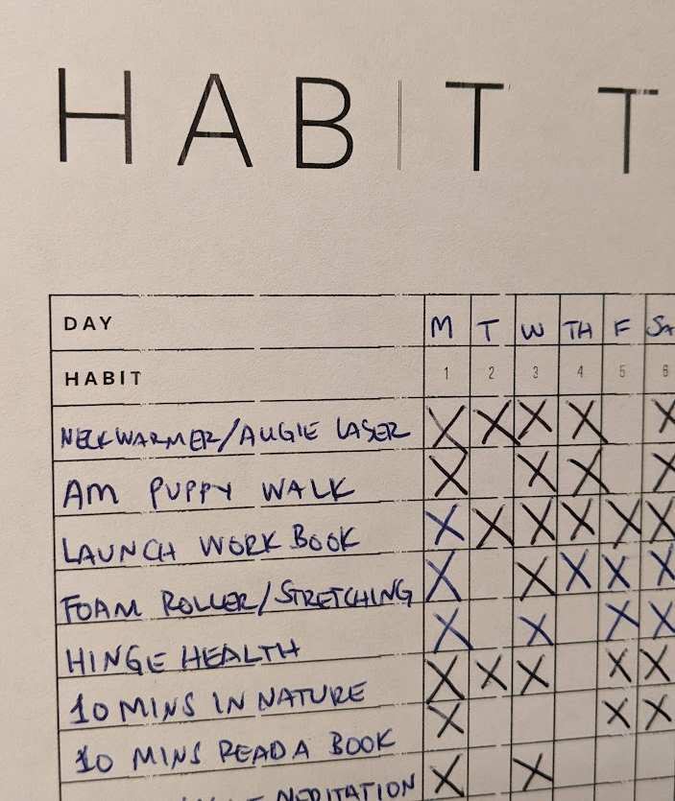
Some of my strategies for getting rest
Try not to work more than 8 hrs/day
Try to limit workweek to 6 days
Try to take actual vacations
Try to focus on what resonates
Work hard to take care of myself
Work hard to limit overextending

Slide 33
Resources adapted from Sacred Rest,
by Dr. Saundra Dalton-Smith

Slide 34
Questions?
I’d be more than happy to share all of these materials with you!
I’d also love to learn about how YOU get rest!
Please don’t hesitate to reach out.
Daphne Richards
CEA-Hort, Travis County | President-elect, Epsilon Sigma Phi
drichards@ag.tamu.edu
512.854.9600

Slide 35
If you are not already a member, please consider joining Epsilon Sigma Phi!
2023 membership window will open in October
espnational.org
2023 ESP National Conference, Billings, MT
September 25 - 28, 2023
Daphne Richards
CEA-Hort, Travis County | President-elect, Epsilon Sigma Phi
drichards@ag.tamu.edu
512.854.9600

