Slide 1
This presentation is the explicit property of Texas Rural Leadership Program and Texas A&M AgriLife Extension Service.
Permission to copy, share, or use this presentation and/or its content is strictly prohibited without written permission.

Slide 2
A Quick Question:
On a scale of 0 – 5 (0=Nonexistent; 5=Extremely)
How relaxed has your day been?

Slide 3
How many of you are more used to this question?
On a scale of 0 – 5 (0=Nonexistent; 5=Extremely)
How hectic/stressful has your day been?
What have we become accustomed to asking and focusing upon?

Slide 4
A Reflection Moment About Community:
Understanding Community as a Step to Problem-Solving
Texas A&M AgriLife Extension Service
Conference 2022
August 17, 2022 – College Station, Texas
Presented by: Scott Cummings, Dr.P.H. & Craig Rotter, PhD

Slide 5
Stop for a second; Who is with us today?
Share: Name and Where YOU identify as HOME, as best you feel.

Slide 6
Objectives for our moments today and into the future of 2022:
Reflect upon fast-paced societal change in recent times
Define the start of community
Analyze community as an element sought by all, including ourselves
Consider the utility of values and the value of self/others

Slide 7
What have the last few years brought us?
Increased unknowns
Loss of what seemed to be constant, reliable, and consistent more often than not
Less trust in institutions and leaders
Fear of changes, elevating anxiety
The inability to live life as it was (at least temporarily)
Changes in our demographics
Greater concerns about our youth (mental health and socialization)
Neo-tribalism (greater loyalty through subsets of identity out of fear of unavoidable or unmanageable cultural shifts and/or change)
And…
A refusal to spend time on things that do not matter
What have the last few years brought you?

Slide 8
What else have the last few years brought us?
An increased focus upon personal identities (what makes each of us “me”)
A greater focus on telling a more complete story of our history/histories
A recognition that our demographics are shifting/changing
A possible pause between what was and what will be
An adjustment in “how” we work and “where” we are when we work
An increased sense of mattering and personal value/values
A naming of values that transcends those in power and in charge
A desire to leave environments no longer perceived as healthy
Anything else you can think of?

Slide 9
Community
Group of people with shared interest, commonalities, or alike in some way
Implies a web of affective relationships (satisfy needs for emotional interactions with significant others; emotional support/attention) that are quantifiably different from those constituting other kinds of human groups (Selznick, 1992)
Being a part of community implies long-term, continuous, social interaction that contributes to the formation of personal identity, and to social and economic production, and reproduction.
Involves commitment to a shared culture, but across cultures, including shared values, norms, and meanings

Slide 10
Why do “WHERE and HOW WE LIVE” matter?
Adds to one’s personal identities
Shapes views and perspectives
May be a determinant of physical and mental health
Factors into access to resources
Helps define our communities
Let’s do a quick reflection.

Slide 11
Factors to consider about LIFE across communities and us (whoever we are):
•
•
•
•
•
•
•
Populations and social structures (exposure through size and density) Economy (what will be sustainable careers over the next 12 years) Institutions (which do we trust, with which do we identify)
Socio-cultural (personal identity; technology use) Infrastructure (technology, upon what structures do we rely) Imagery (how we are perceived; how are our places perceived)
Beliefs about self and others (a realignment of what matters; how we see self and others; who matters to us; who does not)
Start thinking about INTERDEPENDENCE in a deeper, reflective way
(Our existence as a collective and our own existence/time on this planet)

Slide 12
Perhaps we are now chasing “COMMUNITY” over anything else?
Community:
Adds to one’s personal identities
Shapes views and perspectives
May be a determinant of physical and mental health
Factors into access to resources

Slide 13
Activity: With what communities do you personally identify? 5 Types of Community:
Place
Interest
Action
Practice
Circumstance
Let’s quickly go through each.

Slide 14
Every community has leadership needs. Relationships differ based upon needs and how our needs are being met by the communities with which we most identify.
How do local amenities (what work and social places offer) play a role in personal leadership needs being defined and met?
Attitude: Personal leadership is important. Community members can step up
and perform leadership at any given time. You do not have to be THE leader to be A leader who brings positive change and makes changes beyond the status quo.

Slide 15
Possibly shifting values and what is valued

Slide 16
Shift in values/what is valued may include:
Flexibility
Control
Autonomy
Freedom
New skills/experiences
Priorities (family?)
Trust
Safety/security
Less patience for “what no longer matters”
Reflection time
Structure is being redefined
Health and well-being
Personal identity and recognizing the value of others’ identities more and more
A new spirit (opportunity to institute change, like never before)
Positive impact/meaning
“MY” or “OUR” communities (with an elevated “WE-NESS”)

Slide 17
What are our perspectives on differences we make and what living in different communities (think about the 5 types) brings to ALL our lives ?
What are we looking for in the days ahead that is memorable, compelling, relatable, and matters?
Attitude: A realignment of environment and exposure to others may increasingly be defined by shifting our personal value and aligning “what we do” and “how we spend our time” with an energized found/named set of personal values. We are in a GREAT REALIGNMENT.

Slide 18
What are we looking for as possible community issues?
Precision nutrition associated with agriculture
Economic develop related to natural resources
Youth education through STEAM (science, technology, engineering, agriculture, and mathematics
ONE community as a communications starter
Exploring the histories not shared
Identifying sustained activity in what’s needed in the decade ahead
Land ownership (heirs property) and fragmentation of land (divided up)
Underutilized and cared for capitals (assets)
“Who Are We”?
The new face of creative partnerships (internal and external)
Naming the values of communities to which we feel we belong.
Envisioning 10 years from now

Slide 19
WIIFM?
WIIFU?
Texas A&M AgriLife Extension Texas Rural Leadership Program

Slide 20
Demonstration of our Leadership, MOVING FORWARD?
Focus
Time
Energy
Skills
Communications (using technology and face-to-face; frequency?)
Structure
Network
What are the values of the “shifting” community and its leadership (core values)?
How and for what does the “historical” community and its people collectively want to be
known in the days ahead? How do identities play a role in our future?

Slide 21
The best way to know a community is to be a part of that community!!!

Slide 22
Community Problem Solving

Slide 23
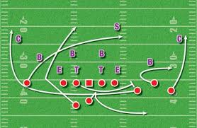
It is All About the Process!!!

Slide 24
Problem-solving is a relational process. It is best accomplished 'in the community'.

Slide 25
Eight Elements of Effective Communities
Wholeness incorporating diversity
A shared culture
Good internal communication
Caring, trust, and teamwork
Group maintenance and governance
Participation and shared leadership tasks
Development of young people (or new members)
Links with the outside world
(Gardner, 1990)

Slide 26
Capitals (Assets) Categories
Agricultural Capital (Assets)
Built Capital/Infrastructure (Assets)
Cultural Capital (Assets)
Educational Capital (Assets)
Financial Capital (Assets)
Health Capital (Assets)
Human Capital (Assets)
Natural Capital (Assets)
Political Capital (Assets)
Recreational Capital (Assets)
Social Capital (Assets)

Slide 27
Models of Community Problem-Solving

Slide 28
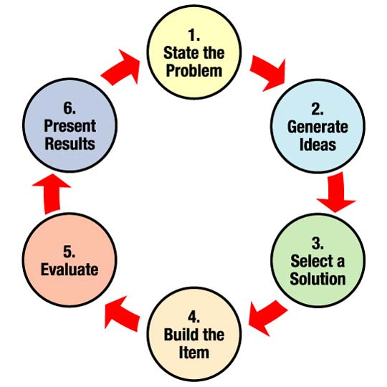
NASA Engineering Process

Slide 29
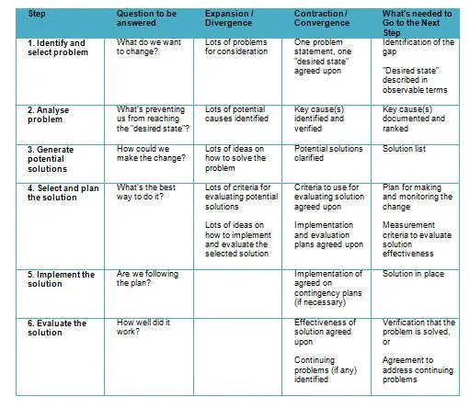
Xerox Problem-Solving Process

Slide 30
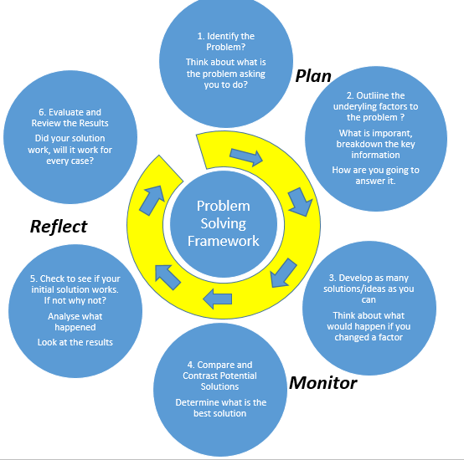
Problem Solving Framework
Bridge Design Problem Solving

Slide 31
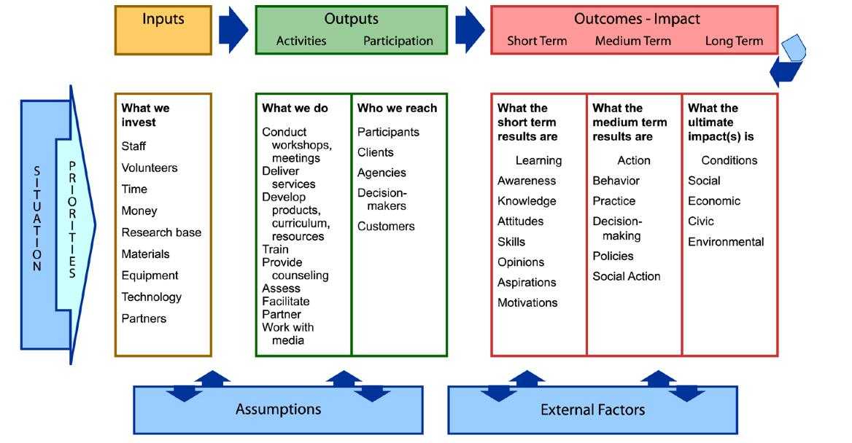
LOGIC Model

Slide 32
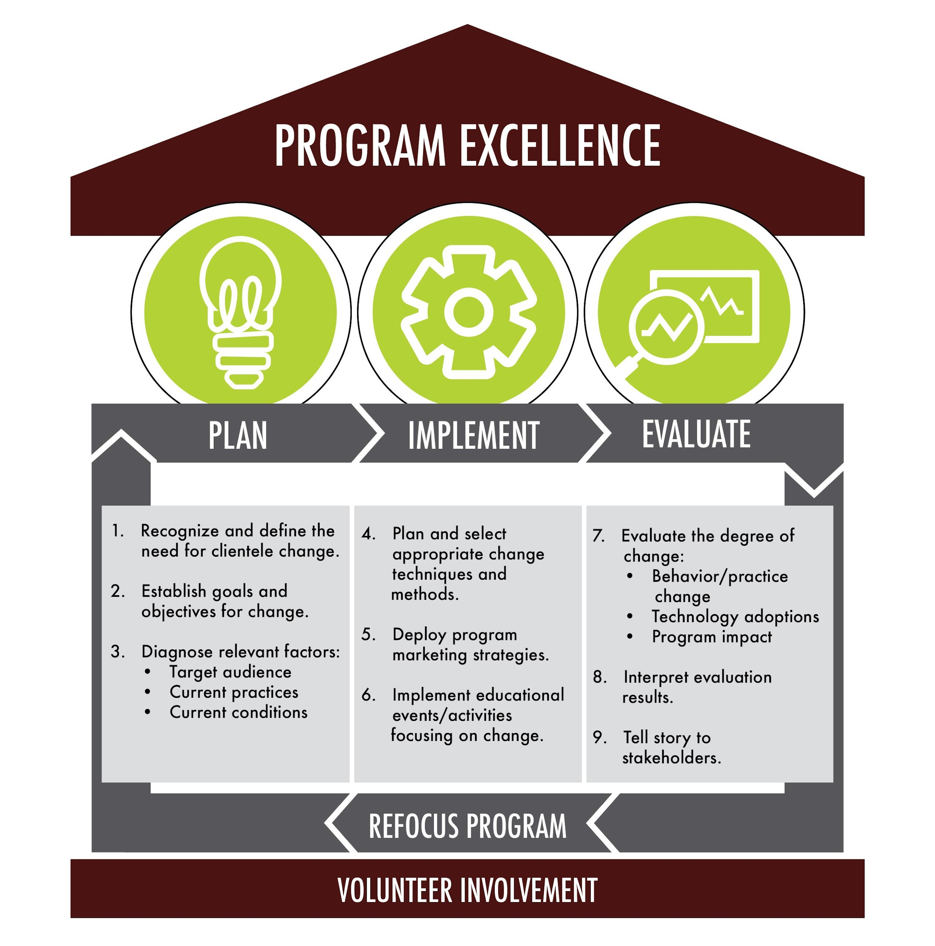
Program Change Model

Slide 33
What is Missing?
All models should…
Start with Why?

Slide 34
Remember…
It is All About the knowing and living your community, and the process!!!

Slide 35
So what’s
next for you?
What are YOU bringing to communities to which you identify/belong?
Texas A&M AgriLife Extension Texas Rural Leadership Program

Slide 36
Questions and Comments
Texas A&M AgriLife Extension
Texas Rural Leadership Program

Slide 37
Contact Info:
Craig Rotter, PhD
Texas Rural Leadership Program
Texas A&M AgriLife Extension Service Texas A&M University
Department of Agricultural Leadership, Education, & Communications
2116 TAMU
College Station, TX 77843 craig.rotter@ag.tamu.edu 979.587.1992
Scott Cummings, Dr.P.H.
Texas A&M AgriLife Extension Service Texas A&M University
Department of Agricultural Leadership, Education, & Communications
2116 TAMU
College Station, TX 77843 scott.cummings@ag.tamu.edu 979.229.3187
TRLP.tamu.edu
facebook.com/txruralleadership/

Slide 38
This presentation is the explicit property of Texas Rural Leadership Program and Texas A&M AgriLife Extension Service.
Permission to copy, share, or use this presentation and/or its content is strictly prohibited without written permission.

