Slide 1
Presentation Template
AGRILIFEEXTENSION.TAMU.EDU
AgriLife Communications

Slide 2
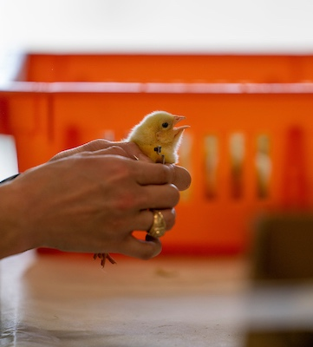
Read Me First
Make a copy of this template
Save this Template somewhere handy. Make a copy of this presentation when you are ready to make it yours.
Read through the template first!
This template includes slide variations as well as tips for you to create your best presentations!
Stick to the brand
Use the embedded brand fonts and colors throughout your presentation for best results.

Slide 3
Using Layout View

Slide 4
For Example
This is a great layout for sharing a screenshot of a web page.
Write a short sentence or two more of detail if you need to. To take screenshots on a Mac, hold down Shift+Command+4

Slide 5
Example Title Slide. Type Your Presentation Title Here.
Your Name, Ph.D., etc.
Title Line 2
Title Line 2

Slide 6
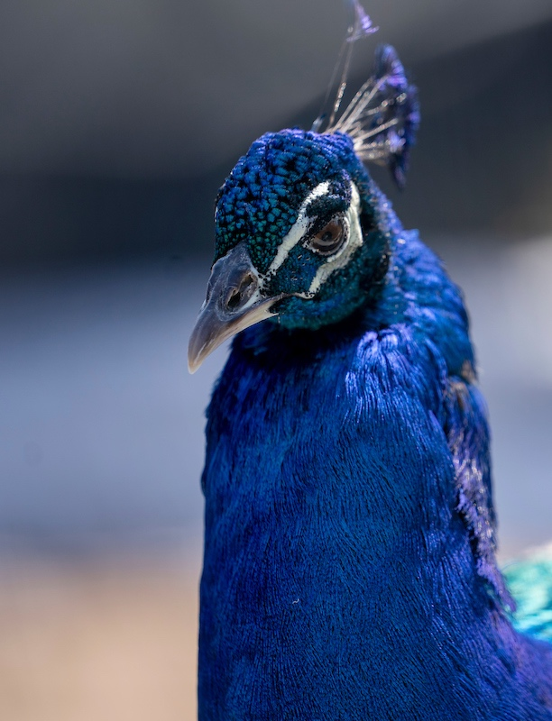
Right Content + Image Layout
You can post a screenshot here. Or delete the iPads and use a photo.
Write a short sentence or two more of detail if you need to. To take screenshots on a Mac, hold down Shift+Command+4

Slide 7
Bar Graph Slides
Use the Chart Design tool to change colors/layouts of the chart.
To change the background photo, right click on it, go to “Change Picture” and then select an option.

Slide 8
This is a Slide for a Lot of Content

Slide 9
Use This Slide to Show Off Your Team!
Name, Ph.D.
Title Line 2
Title Line 2
Name, D.V.M.
Title Line 2
Title Line 2
Name
Title Line 2
Title Line 2

Slide 10
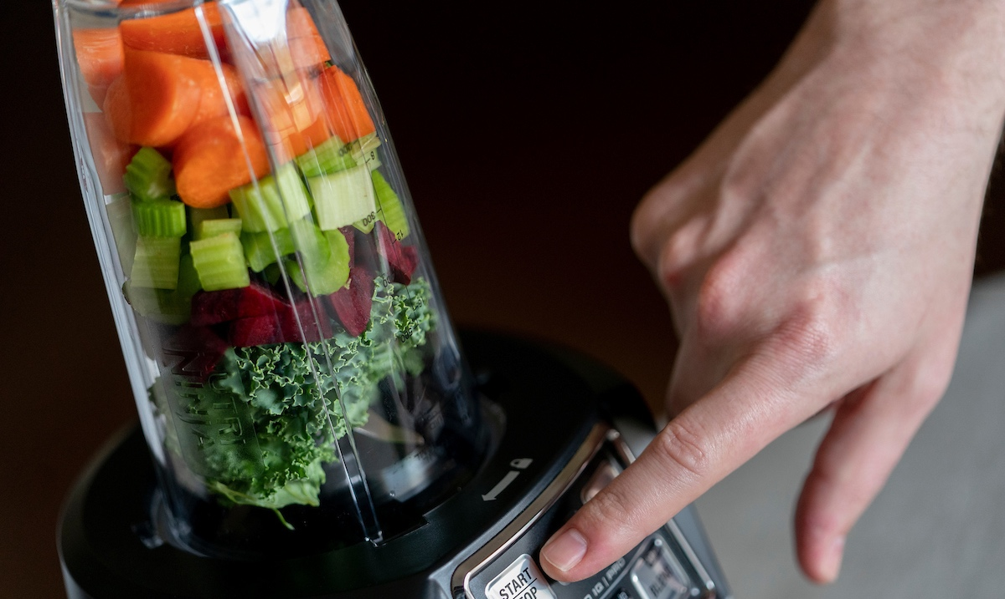
Using Custom Slides
Using “layouts” has a few limitations such as not allowing you to add elements on top of images.
Adapt the following slides for a more dynamic and varied presentation.

Slide 11
Duplicate This Slide to Use it.
Changing a Photo
Pasting Text and Keeping the Format
Keep Content Short and Sweet
To change a photo, right click on it, go to “Change Picture” and then select an option.
When pasting text into a presentation template, use Shift+Option+Command+V
A tiny bit of information here. Remember these are talking POINTS, not epic stories.

Slide 12
Contrasting Topics
Other Contrasting Topic
Duplicate this slide if you wish to use it. Delete the original when you are done.
This is a great format if you want to demonstrate contrasting ideas/thoughts/opinions.
Duplicate this slide if you wish to use it. Delete the original when you are done.
This is a great format if you want to demonstrate contrasting ideas/thoughts/opinions.
Remember, to paste content and keep the formatting used here, use Shift+Option+Command+V.

Slide 13
Use This Slide to Transition to Your Next Big Idea/Topic
Add additional details here if necessary.

Slide 14
Big Impressive Number Slide
$95million
in research spending FY2021
Duplicate this slide and then change out the number you wish to highlight. This will allow you Delete this template slide when you are done.

Slide 15
Use this slide when you have an image to show off.
Add a quote here. Or a single profound statement.

Slide 16
Examples of eye-catching content
Use this slide when you have multiple concepts to show off and discuss and when you have great photography to back it up.

Slide 17
Check List Slide
Nailing down a schedule
It serves a variety of purposes, making presentations powerful tools for convincing and teaching.
Answering questions immediately
It serves a variety of purposes, making presentations powerful tools for convincing and teaching.
Interacting with followers
It serves a variety of purposes, making presentations powerful tools for convincing and teaching.

Slide 18
Numbered Bullets
01
02
03
See how other
profiles are created
Gauge the audience's tastes and preferences
Build a profile apt for
that specific platform
If you’d like to add more content to your presentation, there are plenty of options. You can include photos of your team, descriptions of products, or your goals as a company.
If you’d like to add more content to your presentation, there are plenty of options. You can include photos of your team, descriptions of products, or your goals as a company.
If you’d like to add more content to your presentation, there are plenty of options. You can include photos of your team, descriptions of products, or your goals as a company.

Slide 19
Another way to break apart content
Bullet Point One Could Go Here
Bullet Point Two Could Go Here
Be Consistent With Length
Notice that by creating this grid, we don’t need boring bullets anymore?
Notice that by creating this grid, we don’t need boring bullets anymore?
Try to keep the length consistent so content will fit in each box.
Bullet Point One Could Go Here
Bullet Point Two Could Go Here
Be Consistent With Length
Notice that by creating this grid, we don’t need boring bullets anymore?
Notice that by creating this grid, we don’t need boring bullets anymore?
Try to keep the length consistent so content will fit in each box.

Slide 20
Contact Us
We'd love to talk about
all things Ag.
Phone Number
979.803.1291
Email Address
netid@ag.tamu.edu
Website
agrilife.tamu.edu

